Slide 1
Brighton High School Morning Show
Compiled by David Morse
Current Hardware List and Recommendations
March 2016

Slide 2
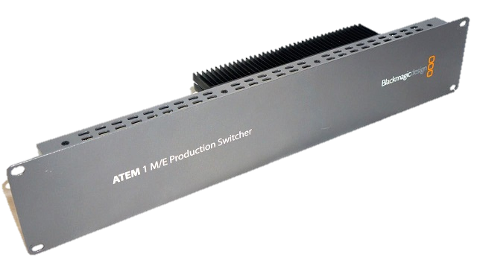
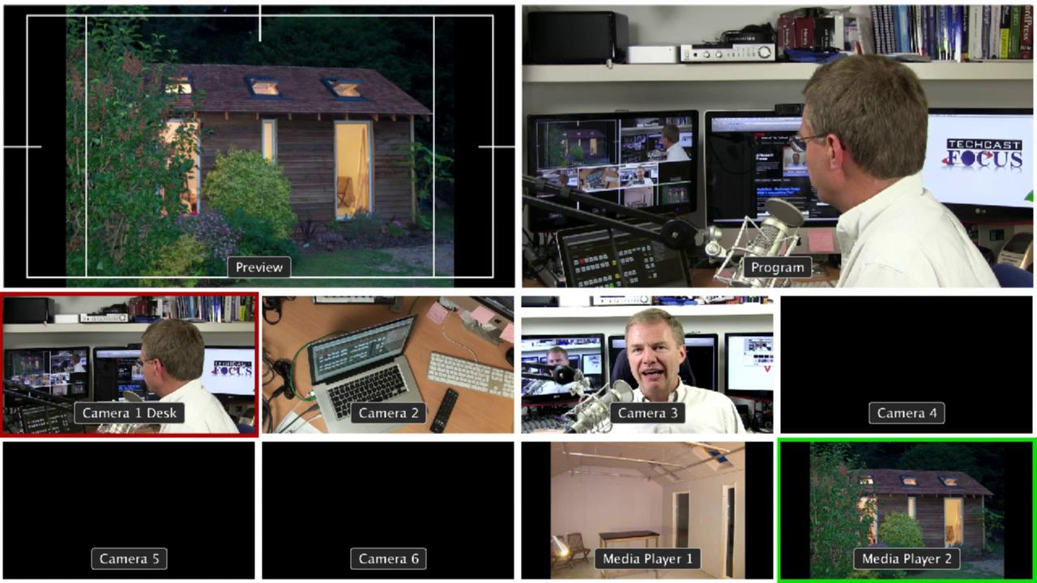
What we have: ATEM 1M/E Switcher
Unavailable
Video Switching

Slide 3
What we recommend: ATEM Production Studio 4K BlackMagic Design
$1610.25
Rack-mount, self-contained panel
Software control via Ethernet
8 inputs, 4 HDMI, 4 SDI
6 outputs
Analog Audio Input
Analog Audio Output
Multiview
Video Switching

Slide 4
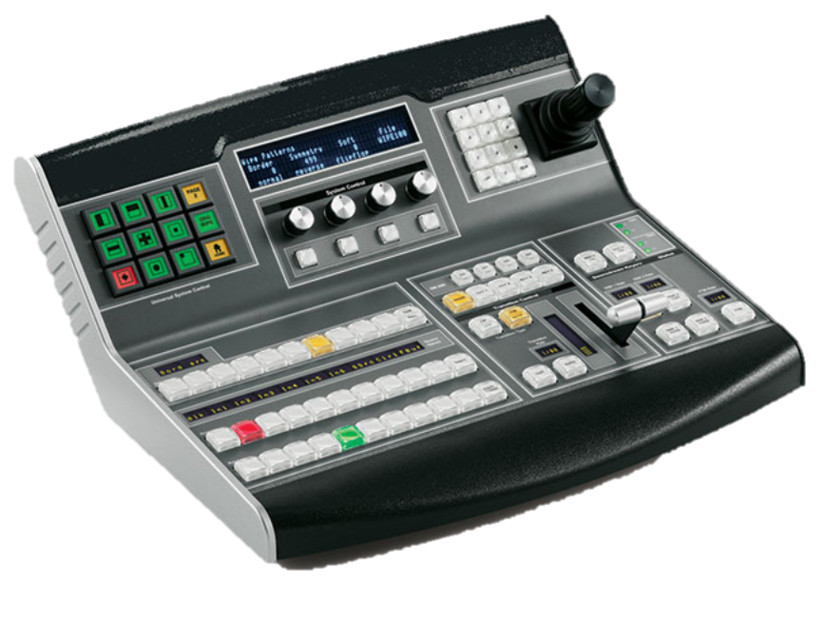
Video Hardware Panel
BlackMagic Design
$4745.25
Direct control of ATEM switcher via Ethernet
Alternative to software control
Video Switching

Slide 5
What we have: Graphics Generator Computer
HP Z230 Workstation
32 GB RAM
AMD FirePro W700
BlackMagic Design Decklink SDI
Intel Xeon
DataVideo CG-500
Graphics / Character Generation

Slide 6
What we recommend: Graphics Generator Computer
ASUS G11CD-US007T Desktop Computer
16 GB DDR4 RAM
NVIDIA GeForce GTX 970
Intel Core i7-6700
BlackMagic Design Decklink SDI 4K
$1679.25
MagicSoft CG 7
Graphics / Character Generation

Slide 7
HP Elitedesk 800 G2 Small Form Factor Desktop
$149.99
Computer used to play videos and music.
DisplayPort to HDMI converter used to attach to switcher
Audio/Video Playing

Slide 8
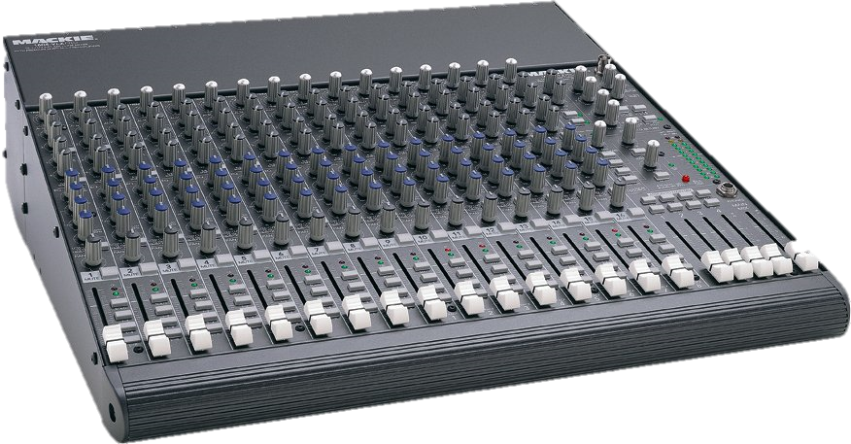
What we have: Mackie 1604 VLZ Pro
16-input Audio Mixer
8 XLR Phantom-Powered Inputs
Per-Channel EQ
XLR Outputs
Audio Mixing

Slide 9
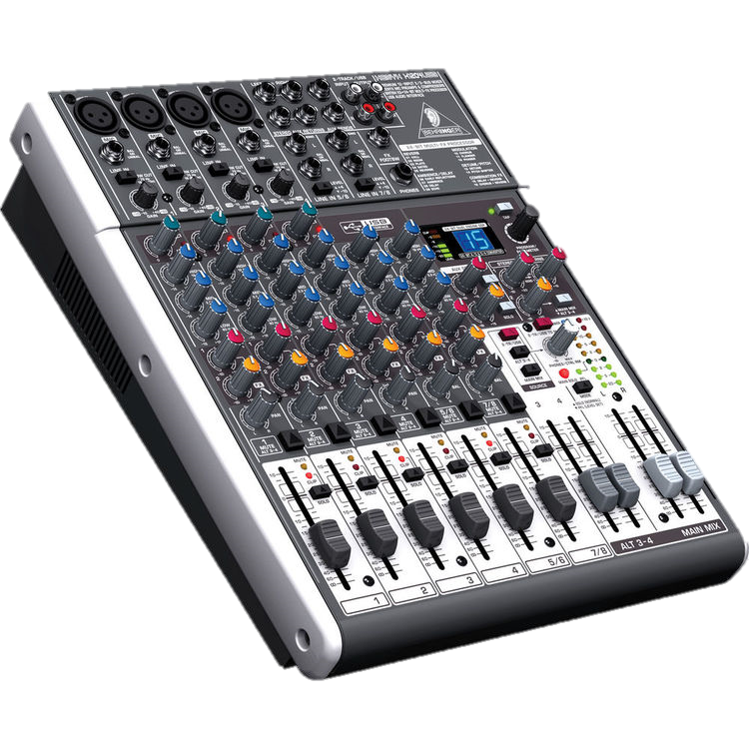
What we recommend: Behringer XENYX X1204 USB
$149.99
12-input Audio Mixer
4 XLR Phantom-Powered Inputs
Per-Channel EQ
XLR Outputs
USB Output
Audio Mixing

Slide 10
HP 260 G1 Desktop Mini PC
$350
Use VGA out to a VGA splitter.
Use computer monitors attached to camera stands.
Prompt! 7.5
+$44
Teleprompter

Slide 11
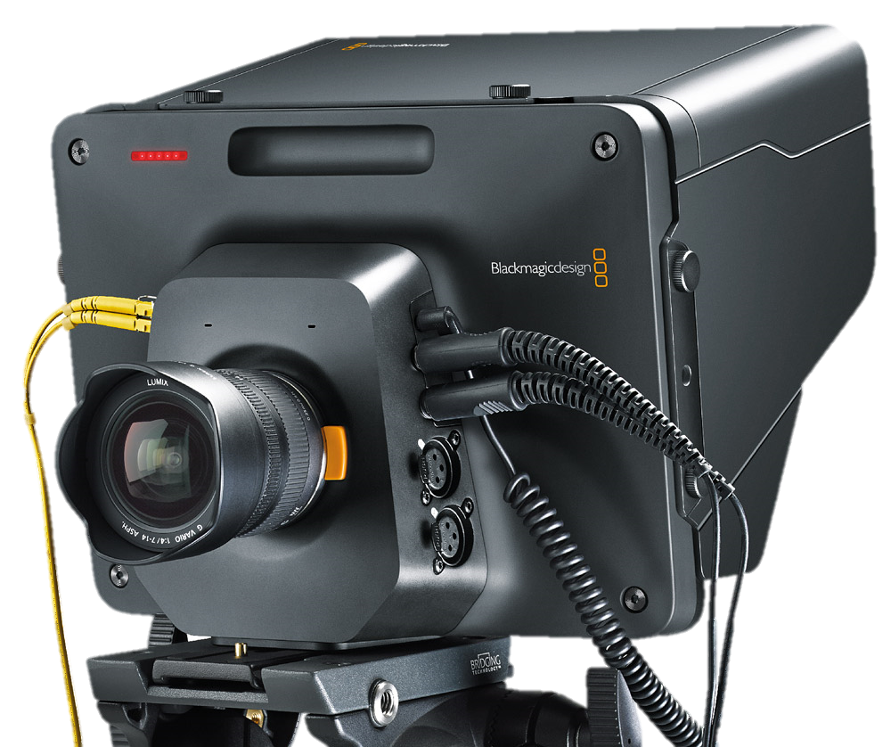
Studio Camera HD
BlackMagic Deisgn
$1695.00
Full HD Recording
Built in Viewscreen
Analog audio inputs with Phantom Power
Panasonic Lumix G Vario
14 – 42MM
$179.95
Cameras

Slide 12
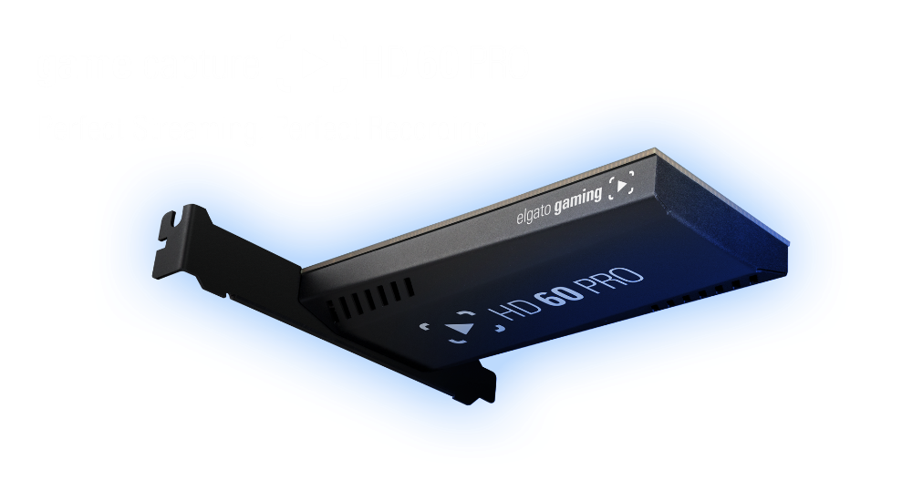
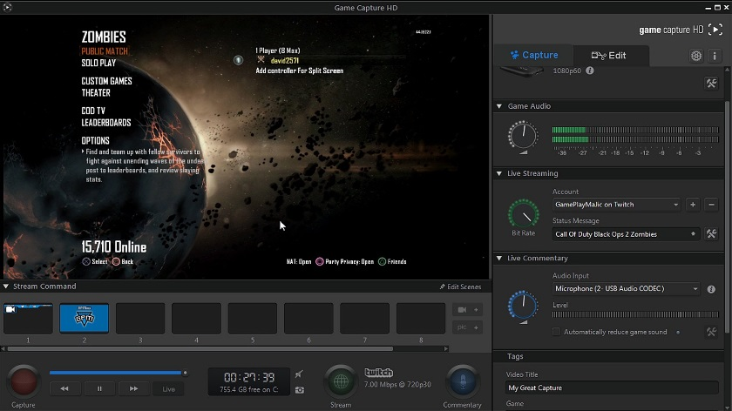
What we have:
$1264.99
Elgato HD 60 Pro
HP Z230 Workstation
8 GB NVIDIA GeForce GTX 970
Intel Core i5
Elgato HD 60 Pro
HDMI Input
HDMI Passthrough
Must be added to a PCI-E slot on computer
Comes with free software for recording/streaming
Video Capture

Slide 13
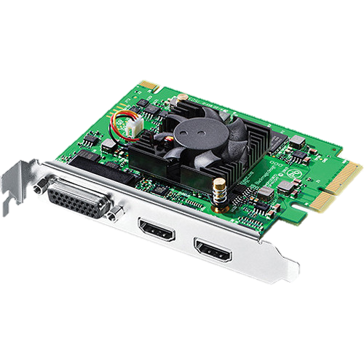
What we recommend:
$1588.05
Intensity Pro 4K
BlackMagic Deisgn
ASUS G11CD-US007T
Desktop Computer
ASUS G11CD-US007T Desktop Computer
16 GB DDR4 RAM
NVIDIA GeForce GTX 970
Intel Core i7-6700
BlackMagic Design Decklink SDI 4K
$1679.25
HDMI Input
HDMI Passthrough
Analog input/output via included breakout cable
Records up to 1080p @ 60FPS or 4K at 30FPS
Must be added to a PCI-E slot on computer
Free drivers download from BlackMagic Design website
Video Capture

Slide 14
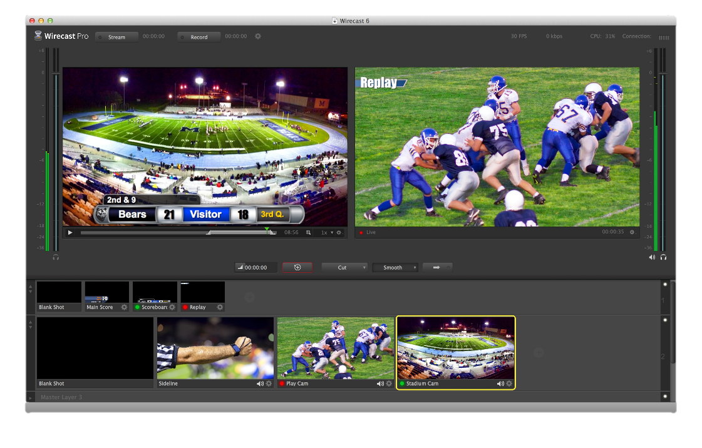
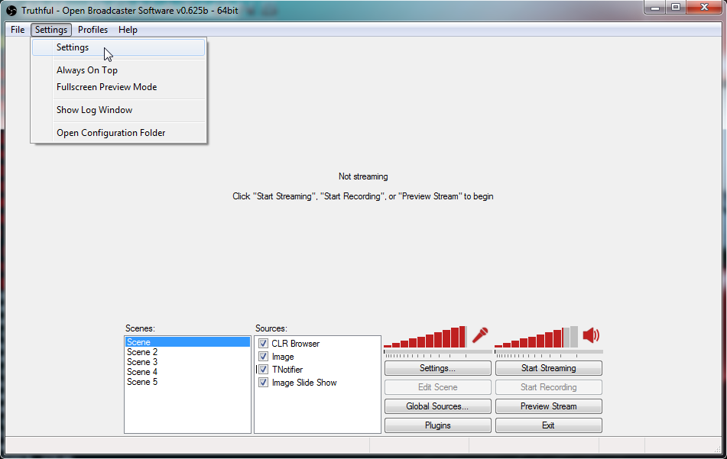
Wirecast 6 Pro
What we recommend:
Open Broadcaster Software
(recommended)
Simple streaming/recording
FREE
Professional streaming/recording
Built in graphics
Audio mixing
Shot switching
$945.25
Streaming / Recording

Slide 15
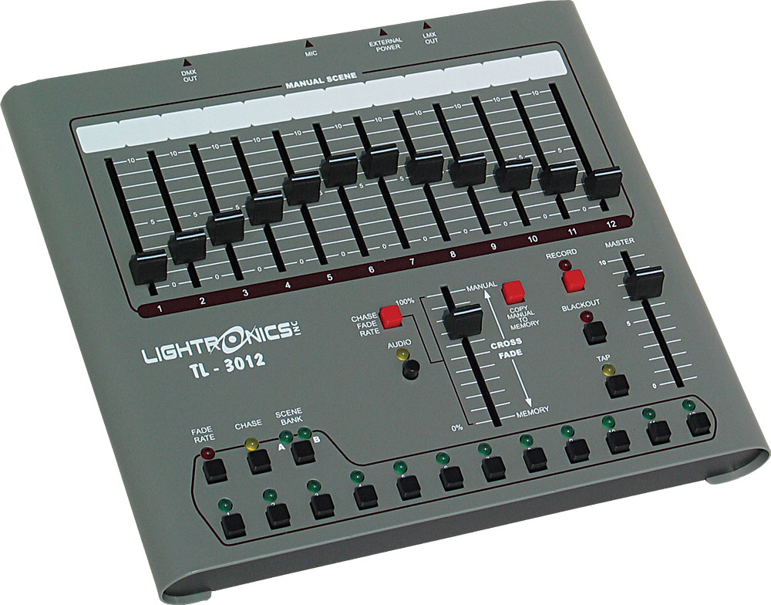
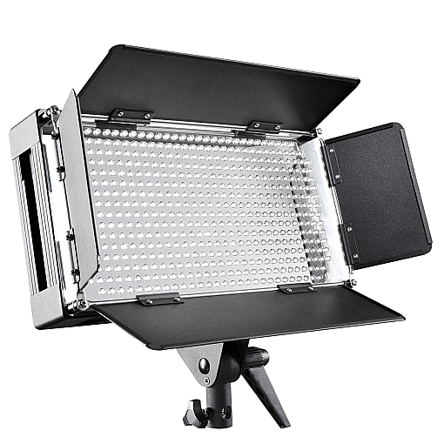
What we have:
What we recommend:
Incandescent Bulbs
Lightronics TL-3012
LED Panels
Lighting

